Slide 1
JAVA Lecture 6
Arrays

Slide 2
What is an Array?
A collection of elements of the same data type, stored in contiguous memory locations.
Each element in an array is accessed using an index (starting from 0).
Why use Arrays?
Stores multiple values in a single variable.
Allows easy iteration and manipulation of data.
Improves memory efficiency

Slide 3
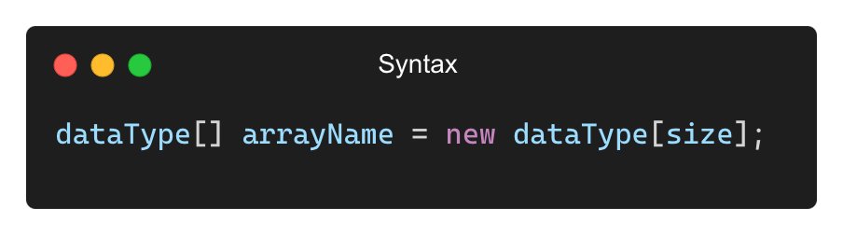
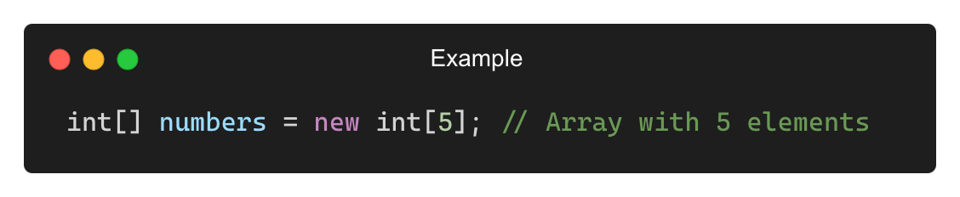
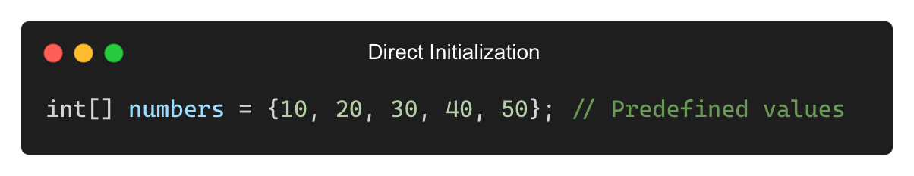
Declaring and Initializing an Array

Slide 4
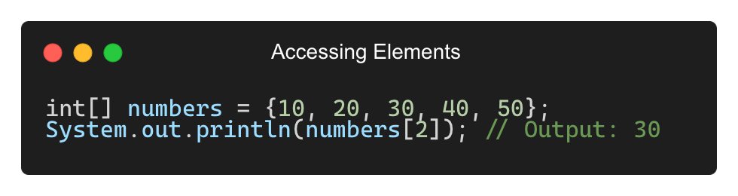
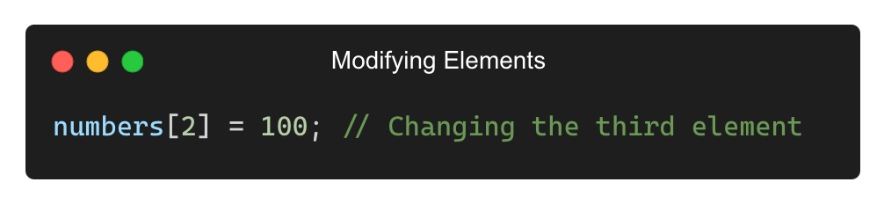
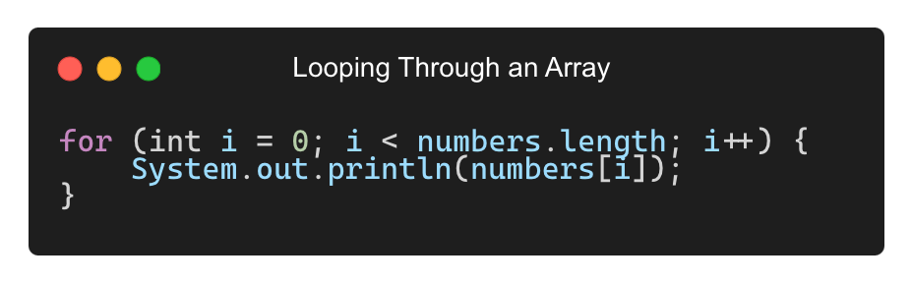
Accessing and Modifying Array Elements

Slide 5
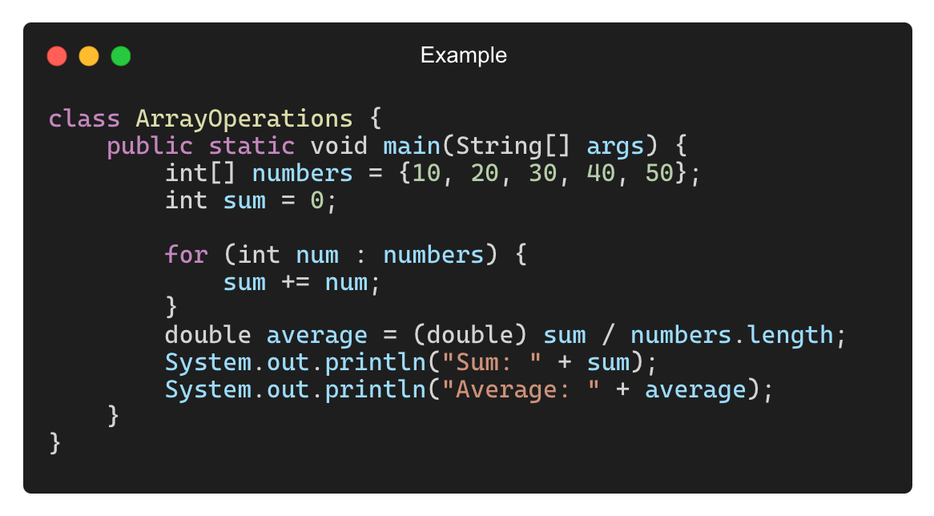
Array Operations (Sum and Average)
Example: Calculate Sum and Average of Elements
Output: Sum: 150
Average: 30.0

Slide 6
Real-World Applications of Arrays
Storing student marks in an exam
Processing large datasets (e.g., temperatures over a week)
Managing user inputs in real-time applications
Sorting and searching operations in algorithms

Slide 7
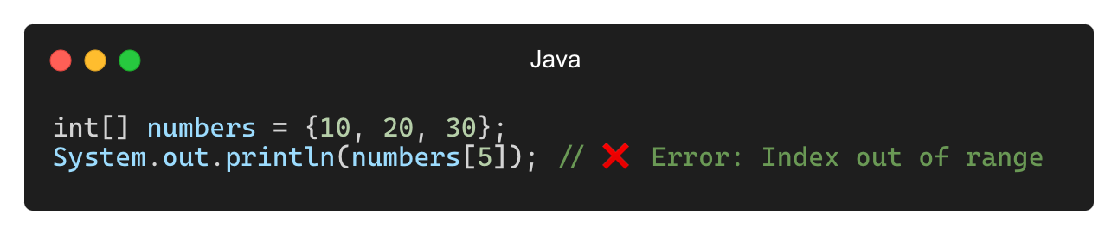
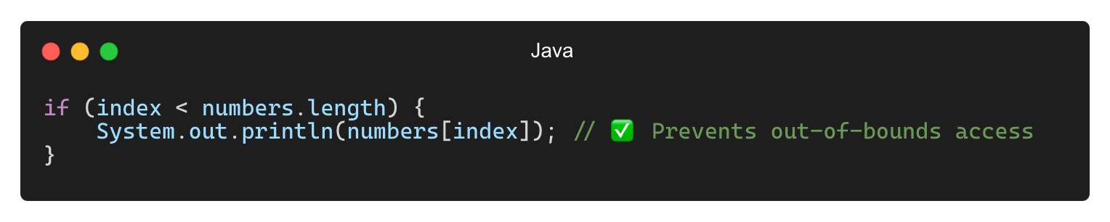
Common Mistakes with Arrays
❌ Accessing Out-of-Bounds Index (ArrayIndexOutOfBoundsException)
✅ Solution:

Slide 8
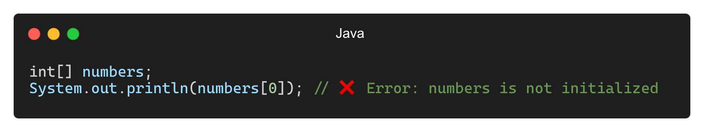
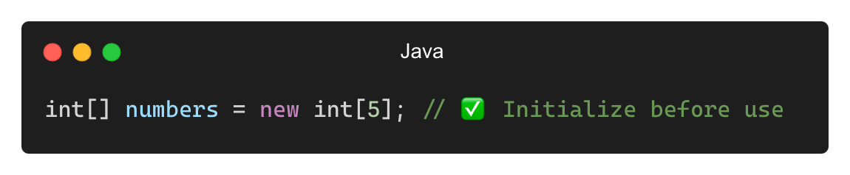
Common Mistakes with Arrays (Contd.)
❌ Using Uninitialized Arrays
✅ Solution:

Slide 9
Best Practices for Using Arrays
Always check array length before accessing elements
Use loops to process array data efficiently
Use meaningful names for arrays (e.g., studentMarks, temperatures)
Consider using ArrayLists if dynamic resizing is needed

Slide 10
THANK YOU

